Slide 1

Institute of Technology of Cambodia Class Level : Foundation Year I2 Department of Applies Mathematics and Statistics Subject : Data Structure & Programming Topic : Bank Management System Project Proposal Group : Rural Work Hard Team Professor : Dr. Bou Channa (Course) Mr. Chan Sophal (TP) Academic Year : 2021-2022

Slide 2
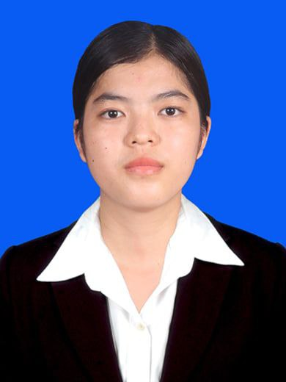
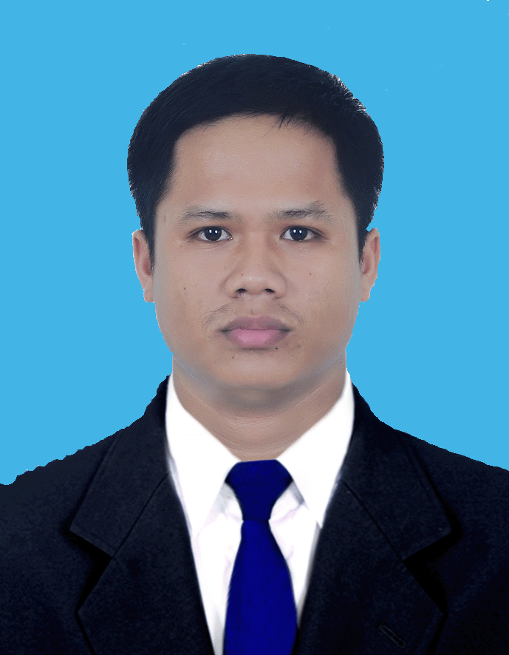
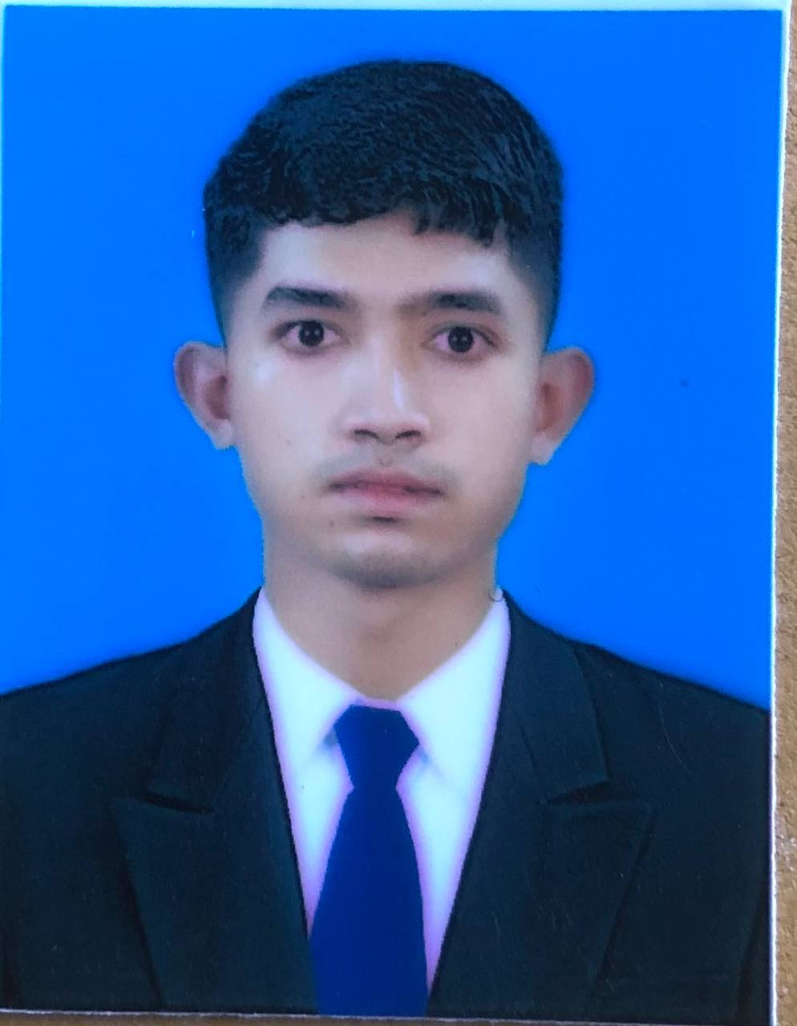
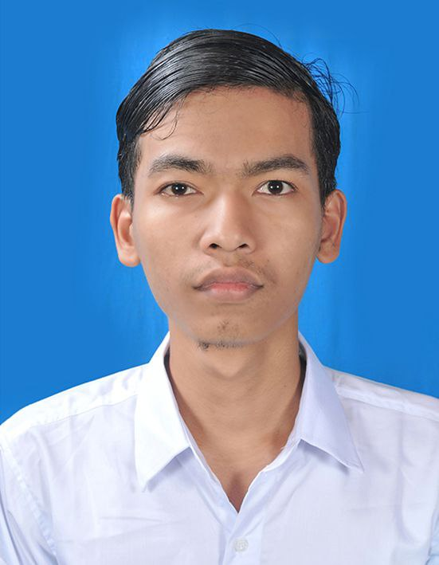
Rural Work Hard Team
Member
Lang Yanut
ID : e20200164
Leader Team
Kry Senghort
ID : e20200706
Member
Ngim Panha
ID : e20200836
Member
Heng Pavisal
ID : e20200291

Slide 3
Contents
Introduction to project
Reasons why we chose this project
Visions & perspectives of project
Processing flow chart of project
Resources & materials applying on project
Working classification & duration
Conclusion

Slide 4
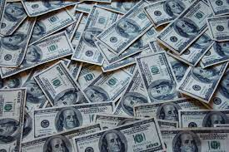


1. Introduction to project
- Manage on bank’s data
Data collection & Analysis
Make comfortable on finance

Slide 5
2. Reasons why we chose this project
Create new thing that is better than old version
Many members need big project
Data Science Field has connection with Financial Engineering
Big project need advance data structure for application

Slide 6

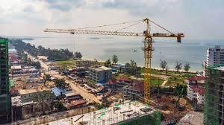
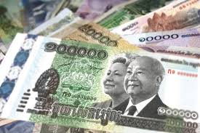
3. Visions & perspectives of project
Cambodia is a developing country
Financial problem is a main problem
Technology bank is a best service of economic development

Slide 7
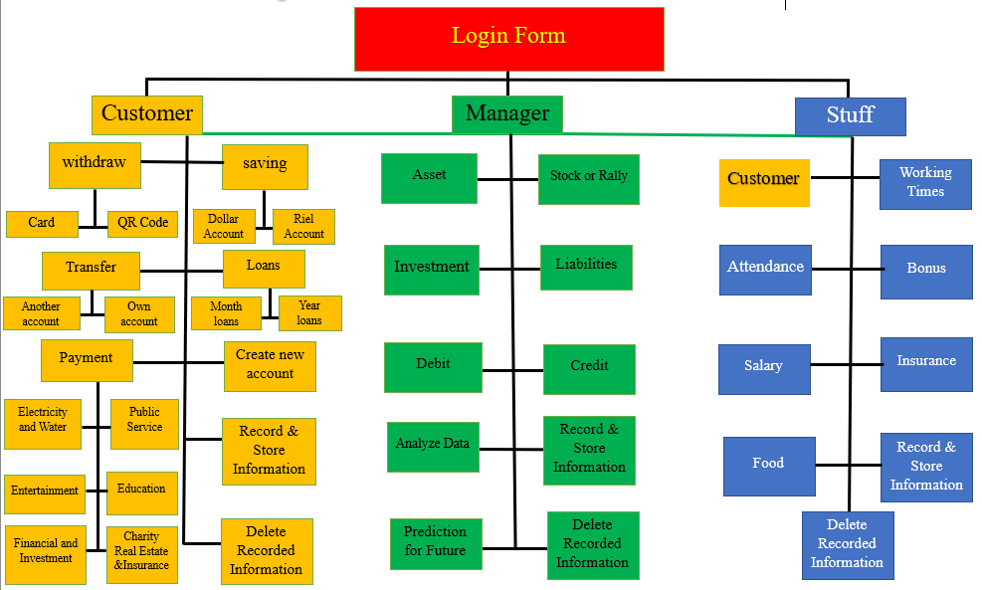
4. Processing flow chart of project

Slide 8



5. Resources & materials applying on project Materials: Recursive Function, Pointer, Linked List, Queue, Stack, Tree Data Structure, Graph Structure, Searching(Heap Search, Binary Search), OOP, SQL

Slide 9

6. Working classification & duration
Kry SengHort : Manager Part
Ngim Panha : Customer Part I
Hengpa Visal : Customer Part II
Lang Yanut : Stuff Part
For this project, we start doing and researching from right now until 16th week. We hope that we will finish in time at week 16th

Slide 10
Conclusion
Bank Management System Project is a big project
We have to use advance data structure to apply on each algorithm
Vision & Perspective focus on economic development.
Technology Financial development is a main problem for living.

Slide 11
Thank you for your paying attention on listening & watching our team’s presentation Good Bye!!!

